Slide 1


Master NumPy: A Step-by-Step Teaching Guide
18 Steps — From Python Lists to Real-World Projects | Beginner Friendly
Notes:
1

Slide 2


STEP 1 · 10 MINUTES
What is NumPy?
Ask students — "If we already have Python lists, why do we need NumPy?"
The Python List Problem
Actual vs. Expected Output
Start with a simple list of numbers:
What Python actually does:
numbers = [10, 20, 30, 40, 50]
print(numbers)
# Output: [10, 20, 30, 40, 50]
numbers * 2
# Output: [10,20,30,40,50,
# 10,20,30,40,50]
Now ask: "Can we multiply every value by 2?"
Students usually try:
Is this what we wanted? No.
We wanted:
# Expected: [20, 40, 60, 80, 100]
numbers * 2
Now introduce NumPy. 🚀
Notes:
2

Slide 3
STEP 2 · 5 MINUTES
Installing NumPy
Install
Import
pip install numpy
import numpy as np
numpy
np
The full package name — installed once on your machine.
The short alias we use in every line of code.
Notes:
3

Slide 4


STEP 3 · 5 MINUTES
Creating Your First NumPy Array
import numpy as np
numbers = np.array([10, 20, 30, 40, 50])
print(numbers)
# Output: [10 20 30 40 50]
# Now multiply
print(numbers * 2)
# Output: [20 40 60 80 100]
Students immediately understand NumPy — one line, no loop, correct result!
Notes:
4

Slide 5

STEP 4
Why NumPy?
❌ Python List (slow)
✅ NumPy (fast)
numbers = [1, 2, 3, 4]
result = []
for i in numbers:
result.append(i * 2)
print(result)
# Need a loop — many lines
numbers = np.array([1, 2, 3, 4])
print(numbers * 2)
# One line. Done.
No loop needed. NumPy operates on the entire array at once.
Notes:
5

Slide 6

STEP 5
Creating Arrays
Method 1 — From List
Method 4 — Range
a = np.array([1, 2, 3])
print(a)
print(np.arange(1, 11))
# Output: [1 2 3 4 5 6 7 8 9 10]
Method 2 — Zeros
Method 5 — Even Numbers
print(np.zeros(5))
# Output: [0. 0. 0. 0. 0.]
print(np.arange(2, 21, 2))
# Output: [2 4 6 8 10 12 14 16 18 20]
Method 3 — Ones
Method 6 — Decimal (linspace)
print(np.ones(5))
# Output: [1. 1. 1. 1. 1.]
print(np.linspace(0, 10, 5))
# Output: [0. 2.5 5. 7.5 10.]
Notes:
6

Slide 7
STEP 6
Array Attributes
a = np.array([10, 20, 30, 40])
print(a.ndim) # 1
print(a.shape) # (4,)
print(a.size) # 4
print(a.dtype) # int64
ndim
shape
Number of dimensions
Rows and columns
size
dtype
Total number of values
Data type of elements
Notes:
7

Slide 8

STEP 7
2D Arrays
marks = np.array([
[80, 90, 95],
[70, 75, 85],
[60, 65, 70]
])
print(marks)
# Attributes
print(marks.shape) # (3, 3)
print(marks.ndim) # 2
print(marks.size) # 9
2D Array
Rows
A 2D array is like a table
3 Students (rows)
Columns
3 Subjects (columns)
Notes:
8

Slide 9
STEP 8
Indexing
1D Indexing
2D Indexing
a = np.array([10, 20, 30, 40, 50])
print(a[0]) # 10
print(a[2]) # 30
print(a[-1]) # 50
marks = np.array([
[80, 90, 95],
[70, 75, 85],
[60, 65, 70]
])
print(marks[0]) # [80 90 95]
print(marks[1]) # [70 75 85]
print(marks[2]) # [60 65 70]
# Single value
print(marks[1][2]) # Output: 85
marks[1][2] → Row 1, Column 2 → 85
Notes:
9

Slide 10

Reshaping and Transposing
arr = np.arange(12) # [0, 1, 2, ..., 11]
matrix = arr.reshape(3, 4) # 3 rows, 4 cols — same data
flat = matrix.flatten() # Back to 1D (copy)
T = matrix.T # Transpose: 4 rows, 3 cols
# ML use-case: align dimensions
# Input shape (1000, 28, 28) → reshape to (1000, 784)
reshape vs flatten: .reshape() returns a view when possible. .flatten() always returns a copy. Use .ravel() for a faster flat view.
Notes:
10

Slide 11
Elementwise Operations — No Loops!
❌ Old Way (Slow)
✅ NumPy Way (Fast)
result = []
for x in my_list:
result.append(x * 2 + 5)
# Slow Python loop
arr = np.array([1, 2, 3, 4])
arr * 2 + 5 # [7, 9, 11, 13]
arr ** 2 # [1, 4, 9, 16]
arr1 + arr2 # Element by element
arr1 * arr2 # Multiply each pair
NumPy applies operations to every element simultaneously using compiled C loops — often 10–100× faster than Python iteration.
Notes:
11

Slide 12
CHAPTER 3
Advanced Power
Universal functions, aggregation, boolean filters, and broadcasting.
Notes:
12

Slide 13



Stacking and Splitting Arrays
a = np.array([1, 2, 3])
b = np.array([4, 5, 6])
# Stacking
np.vstack([a, b]) # [[1,2,3],[4,5,6]] ← vertical
np.hstack([a, b]) # [1,2,3,4,5,6] ← horizontal
# Splitting
m = np.arange(12).reshape(4, 3)
parts = np.split(m, 2) # Two 2×3 arrays
Collect
Stack
Split
Gather separate data sources
Combine with vstack / hstack
Partition into train/test sets
Notes:
17

Slide 14

Statistical Functions on Real Data
data = np.array([23, 45, 12, 67,
34, 89, 56, 22])
np.mean(data) # 43.5
np.median(data) # 39.5
np.std(data) # 24.8
np.var(data) # 617.75
np.percentile(data, 75) # 59.75
np.corrcoef(x, y) # Correlation matrix
Why It Matters
Descriptive Stats
Summarize datasets instantly without Pandas.
Outlier Detection
Use std deviation to find anomalies.
Feature Engineering
Normalize and scale features for ML models.
Notes:
19

Slide 15
Random Number Generation
# Reproducibility — always set a seed first!
np.random.seed(42)
np.random.rand(3, 3) # Uniform [0, 1)
np.random.randn(5) # Standard normal (mean=0, std=1)
np.random.normal(0, 1, 1000) # Normal: mean=0, std=1, n=1000
np.random.randint(1, 100, 10) # 10 integers between 1 and 99
np.random.choice([1,2,3,4], 5) # Random sampling
Always call np.random.seed(42) before generating random data in experiments so results are reproducible by anyone running your code.
Notes:
20

Slide 16
CHAPTER 5
Visualization & Insight
Turning raw arrays into meaningful visual representations with Matplotlib.
Notes:
22

Slide 17

2D Arrays as Datasets
A 2D NumPy array is the natural structure for tabular data — each row is a sample, each column is a feature.
# Simulate a dataset: 5 students, 3 exam scores each
dataset = np.array([
[85, 90, 78], # Student 1
[72, 68, 80], # Student 2
[91, 95, 88], # Student 3
[60, 55, 70], # Student 4
[77, 82, 85], # Student 5
])
print(dataset.shape) # (5, 3) → 5 rows, 3 columns
Rows = Samples
Columns = Features
Shape = (n, m)
Each student / observation
Each exam / measurement
n samples, m features
Notes:
23

Slide 18

Features (X) and Target (y)
The most critical split in machine learning: separate your input features from your prediction target.
# Dataset: [Math, Science, English, Pass/Fail]
data = np.array([
[85, 90, 78, 1],
[72, 68, 80, 1],
[40, 45, 55, 0],
[91, 95, 88, 1],
[30, 28, 40, 0],
])
X = data[:, :-1] # All rows, all columns EXCEPT last → Features
y = data[:, -1] # All rows, ONLY last column → Target
print(X.shape) # (5, 3)
print(y.shape) # (5,)
This X / y split is the universal convention in Scikit-Learn, Keras, and every ML framework. NumPy slicing makes it a one-liner.
Notes:
24

Slide 19

Mini Machine Learning Example
Bringing it all together — a full prediction pipeline using only NumPy.
Notes:
25

Slide 20

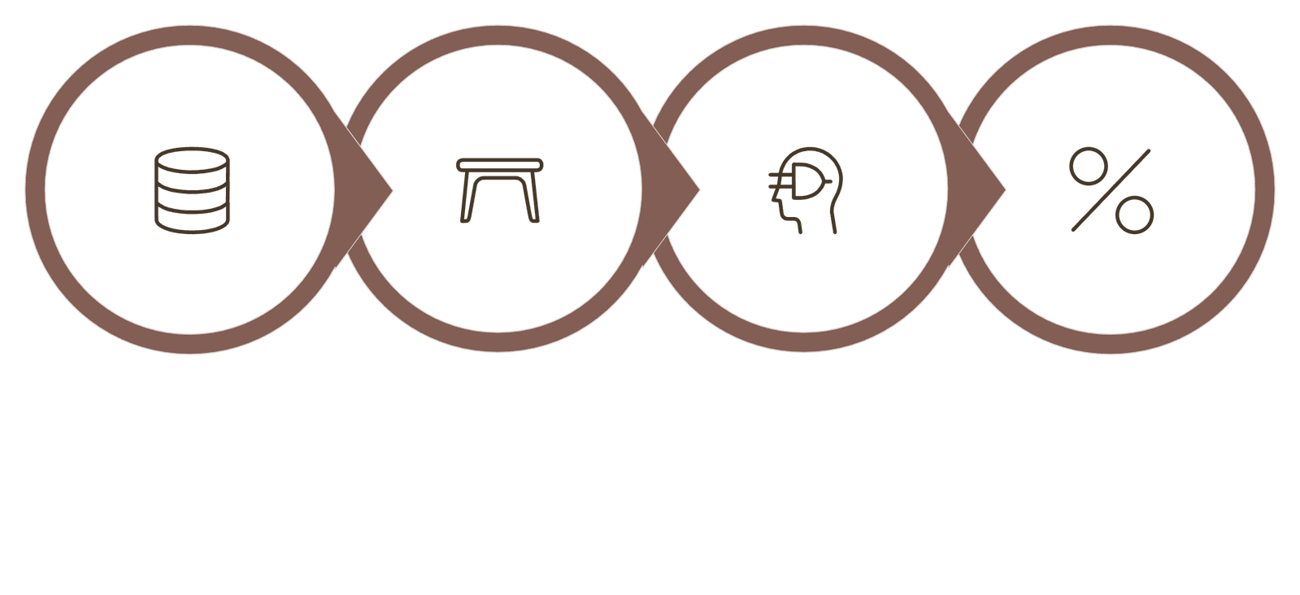
Predict Exam Pass/Fail with NumPy
np.random.seed(42)
# Step 1: Create synthetic dataset
X = np.random.normal(70, 15, (100, 3)) # 100 students, 3 scores
y = (X.mean(axis=1) >= 65).astype(int) # Pass if avg ≥ 65
# Step 2: Extract features and target (already done!)
# X.shape = (100, 3), y.shape = (100,)
# Step 3: Simple threshold classifier
predictions = (X.mean(axis=1) >= 65).astype(int)
# Step 4: Evaluate accuracy
accuracy = np.mean(predictions == y) * 100
print(f"Accuracy: {accuracy:.1f}%") # 100.0%
Make Predictions
Create Dataset
Extract X & y
Evaluate
Notes:
26

Slide 21

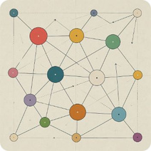
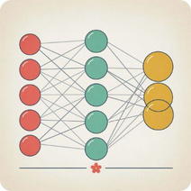

The Power of the Ecosystem
Pandas
Scikit-Learn
TensorFlow / PyTorch
Matplotlib
DataFrames are built on NumPy arrays. Every column is a NumPy array under the hood.
All ML models expect NumPy arrays as input. The fit(X, y) pattern is universal.
Tensors are multi-dimensional arrays — conceptually identical to NumPy arrays.
Every plot takes NumPy arrays as input for axes, image data, and transformations.
Notes:
27

Slide 22



Performance in the Real World
Key Principles
1
Vectorize Everything
2
Use Correct Data Types
Replace all Python for loops with array operations for 10–100× speedups.
Specify dtype=np.float32 for GPU compatibility. Avoid silently mixing int and float.
3
Leverage Hardware
NumPy arrays feed directly into GPU/TPU backends via CuPy, JAX, and PyTorch.
Notes:
28

Slide 23


The Future of Scientific Computing
NumPy 2.x
Industry Standard
Better compatibility, improved type handling, and performance gains for modern hardware.
The Scientific Python stack powers research at CERN, NASA, DeepMind, and beyond.
Your Next Step
Master NumPy arrays → then Pandas → then Scikit-Learn → build and deploy real models.
Notes:
29

Slide 24

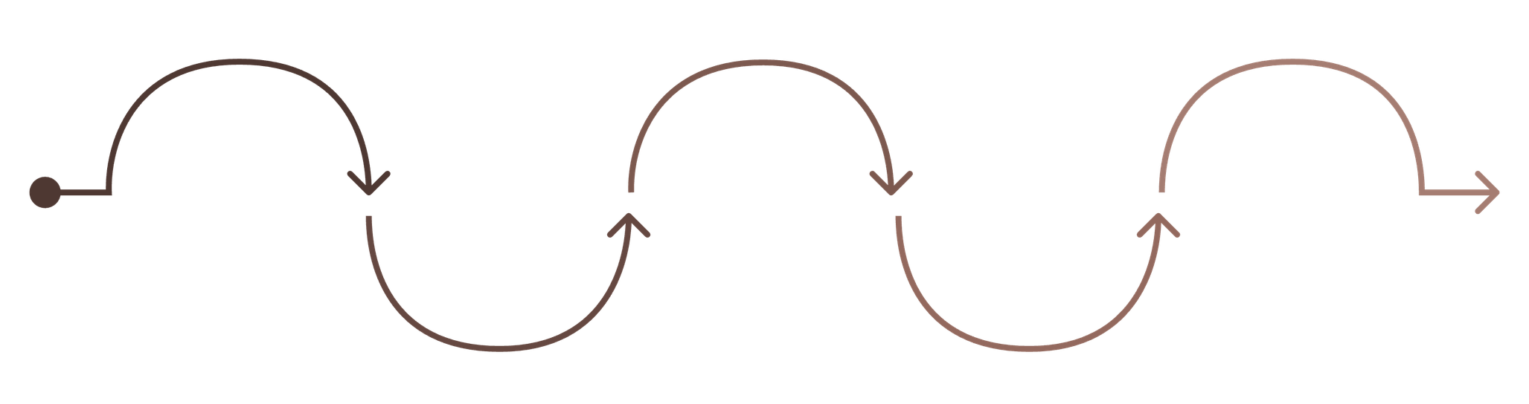
Key Takeaways
Python Lists
Indexing & Slicing
Math & Stats
2D Datasets
NumPy Arrays
Basic sequences for small data
Vectorized operations and summaries
Rows as samples, columns as features
Fast, fixed-type numerical arrays
Access and slice X and y efficiently
🧱 Foundation
⚡ Speed
Arrays replace lists for any numerical work
Vectorization eliminates slow Python loops
📊 Data Shape
🚀 Ecosystem
X and y slicing is the core of every ML model
NumPy unlocks Pandas, Sklearn, and deep learning
Notes:
30

Slide 25
Notes:
31

